Slide 1
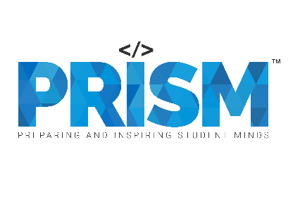

| Tech Management, SRI-B
CLAWS
CLASH OF THE
Ramaiah Institute Of Technology
AgentXecution
AI Multi-Agent Execution Operating System
Pooja N
Mandhara N
Pritika Singh
Ritika Verma

Slide 2
Idea
Problem Statement
“In student projects, hackathons, and team meetings, tasks are often discussed verbally but later forgotten, delayed, or manually tracked across chats and notes. Teams spend more time coordinating work than actually executing it.” We selected the On-device Productivity + GenAI theme because we wanted to solve a real workflow problem faced during collaborative projects. AgentXecution converts meeting conversations into structured tasks, smart assignments, risk predictions, and continuously monitored workflows using an OpenClaw-inspired multi-agent AI system. Target users include student teams, startup teams, project managers, and remote collaboration groups.

Slide 3
Idea
Current Solution & Gaps
Most existing meeting tools focus only on transcription or note-taking. They capture conversations but do not actively execute workflows, predict delays, monitor risks, or manage task ownership intelligently. Current solutions: • Meeting transcription tools • Notes and productivity apps • Manual Trello/Notion workflows What is missing: • Autonomous execution • AI-driven workflow monitoring • Smart reassignment and risk prediction • Continuous task tracking

Slide 4
Idea
Our Solution
AgentXecution is an OpenClaw-inspired AI multi-agent execution system that listens to meetings, extracts tasks, predicts risks, assigns work intelligently, monitors progress continuously, and assists teams in completing workflows autonomously. Key Features: • Voice-to-task execution • Automatic task extraction • Deadline & owner detection • Multi-agent orchestration • Risk prediction engine • Delay probability analysis • Smart reassignment • Undo/history system

Slide 5
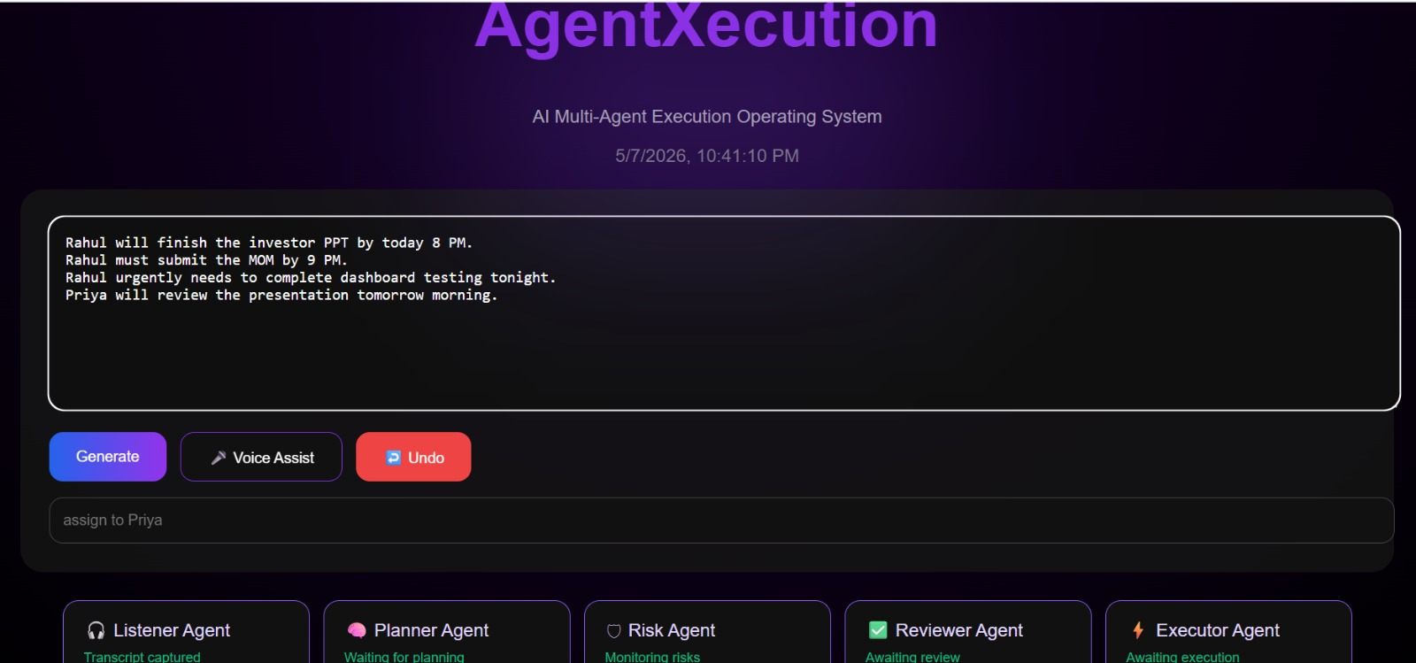
Idea
Demo/Product Walkthrough
Meeting Input
- User provides meeting transcript through text or voice.

Slide 6
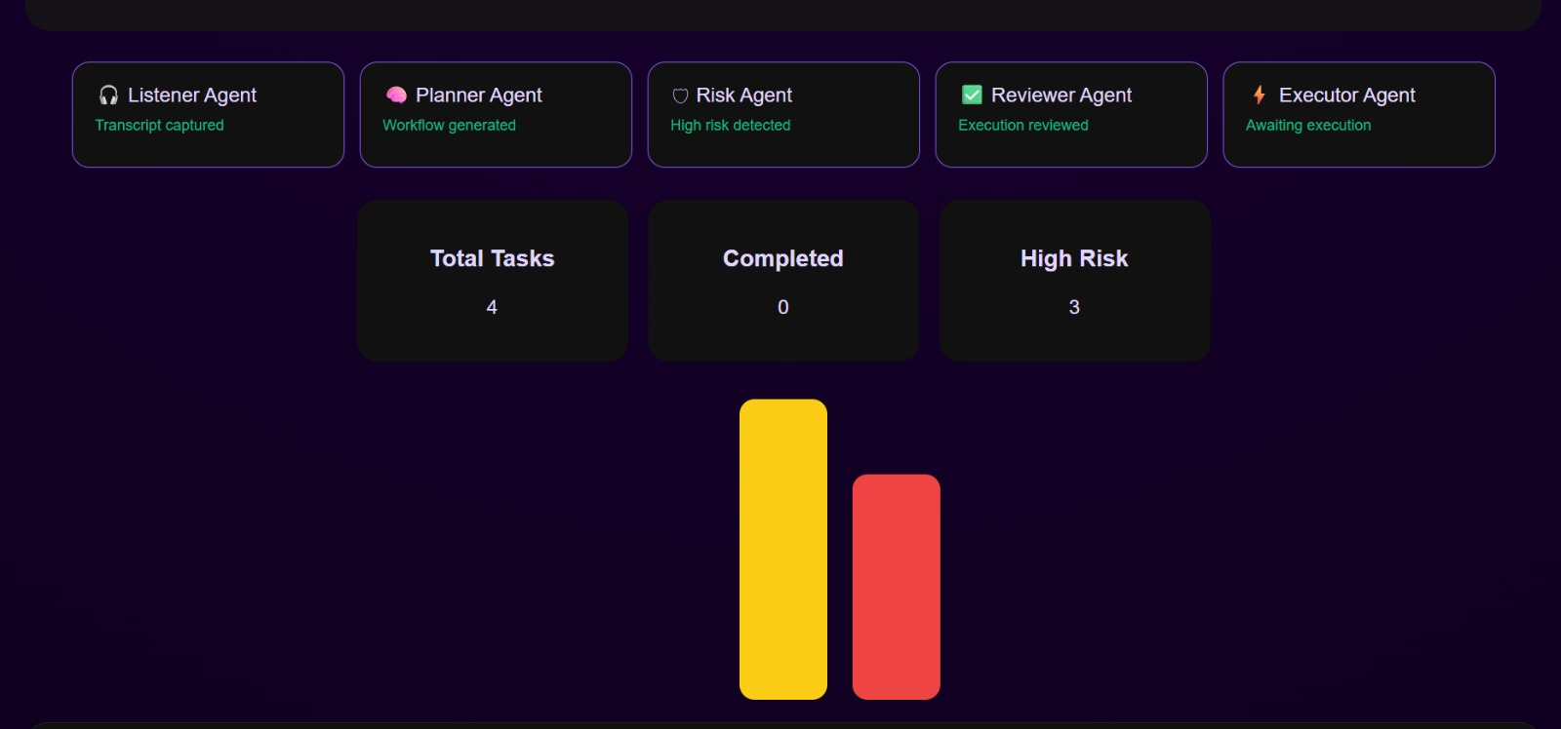
Idea
Demo/Product Walkthrough
Multi-Agent Activation
- Listener, Planner, Risk, Reviewer and Executor Agents collaboratively process workflow

Slide 7
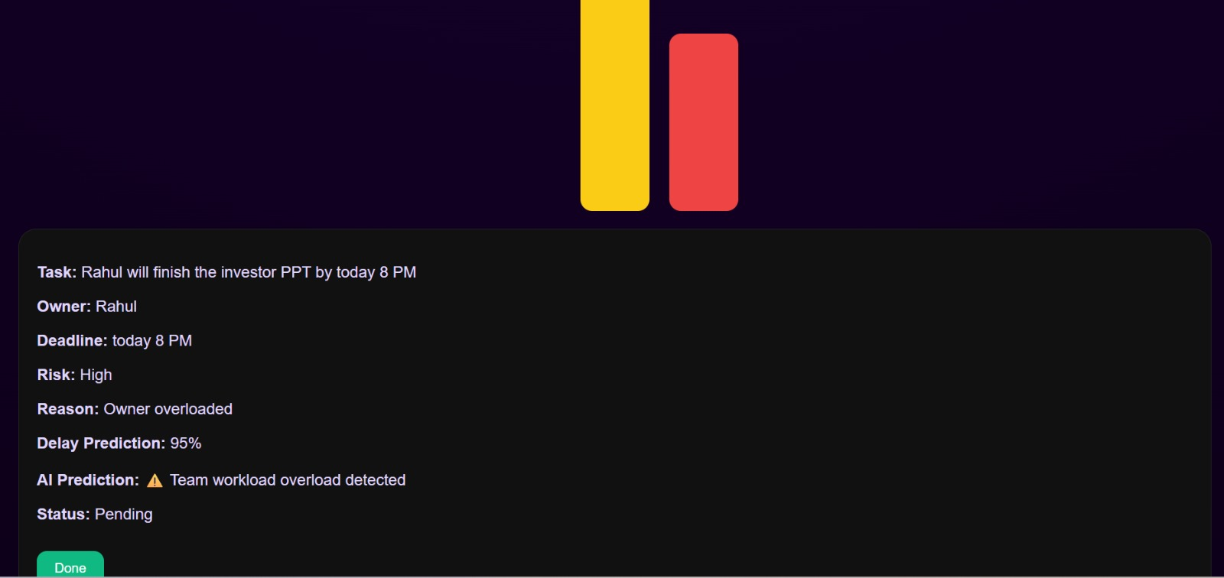
Idea
Demo/Product Walkthrough
Risk Prediction
- The Risk Agent predicts overloads, delays, and workflow bottlenecks in real-time

Slide 8
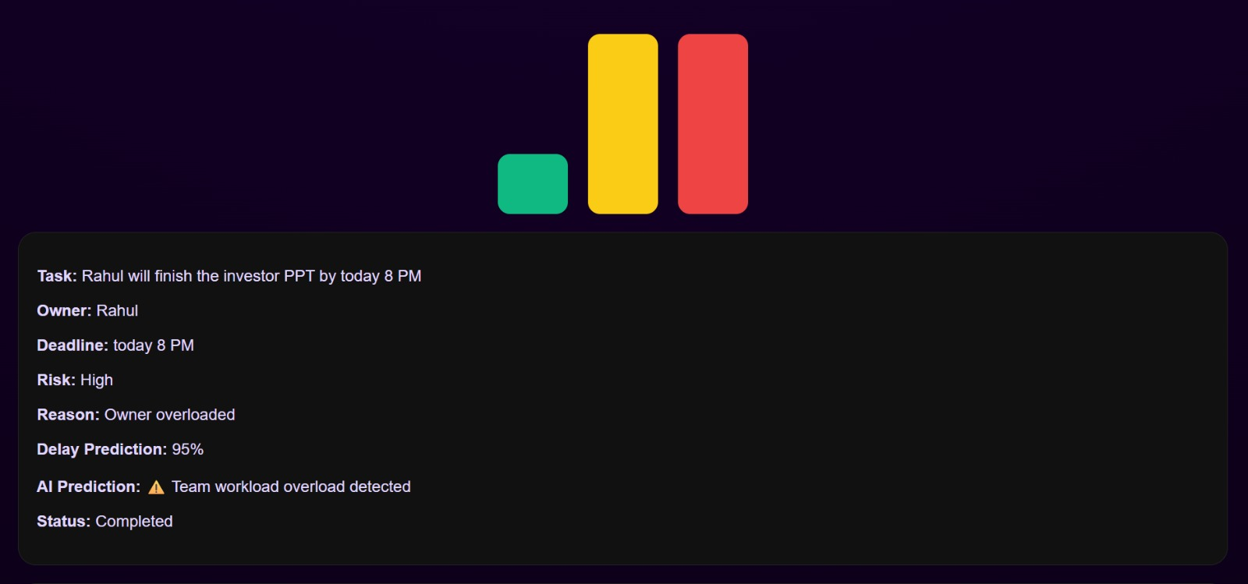
Idea
Demo/Product Walkthrough
Task Completion
- Tasks can be tracked, completed and monitored dynamically

Slide 9
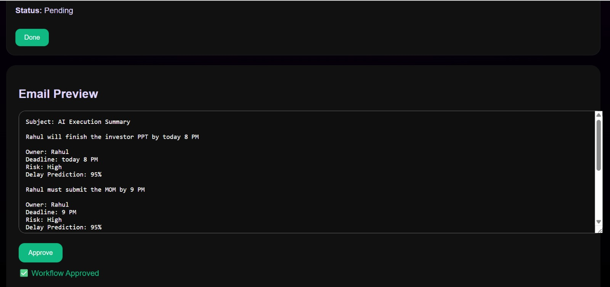
Idea
Demo/Product Walkthrough
Email Approval
- Reviewer Agent prepares AI-generated workflow summaries for approval

Slide 10
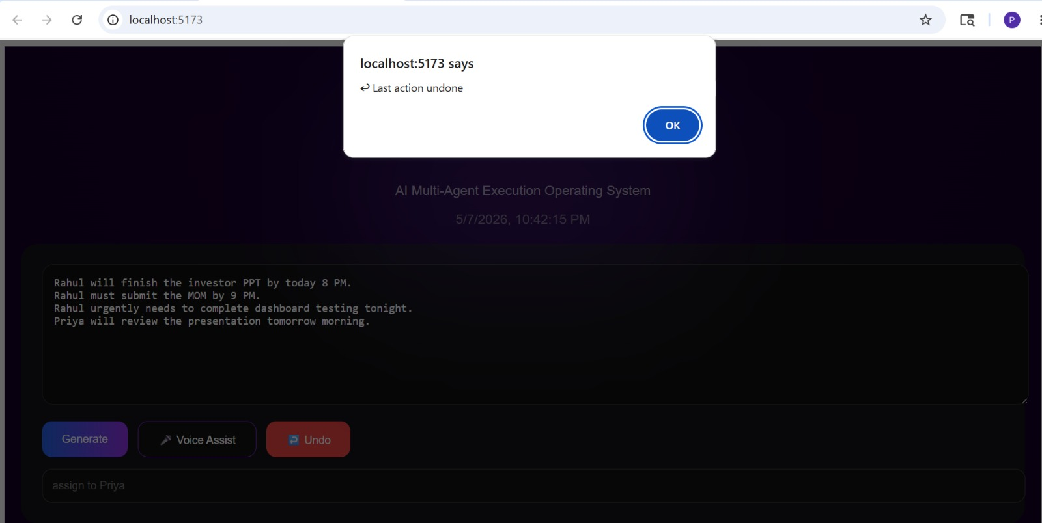
Idea
Demo/Product Walkthrough
Undo System
- Users can instantly undo the last workflow action

Slide 11
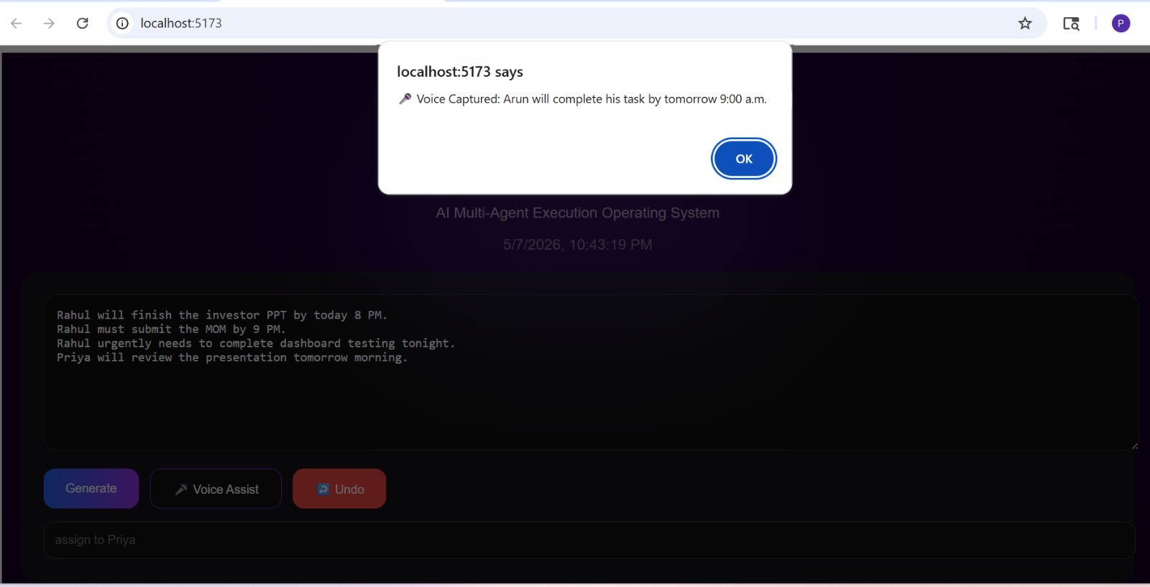
Idea
Demo/Product Walkthrough
Voice Assistant
- The voice assistant captures spoken meeting instructions

Slide 12
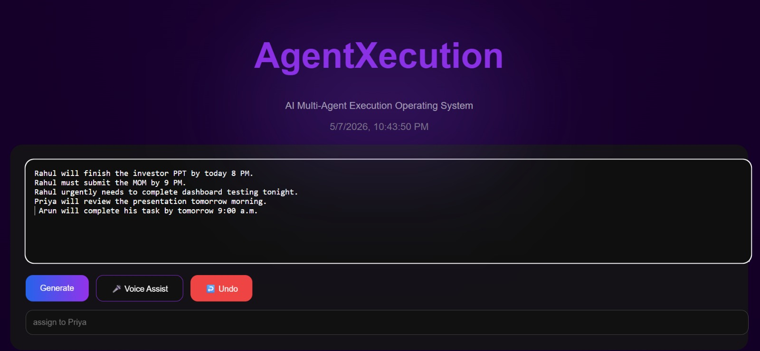
Idea
Demo/Product Walkthrough
Live Voice Input
- Speech-To-Text converts voice conversations directly into actionable tasks

Slide 13
Idea
Tech & Architecture
Frontend: • React.js • Vite • JavaScript Backend: • FastAPI • Python AI Layer: • OpenClaw-inspired multi-agent orchestration • Natural language command engine • Workflow prediction system Memory + Monitoring: • JSON memory system • Heartbeat engine • Action logs + history tracking Workflow: Voice/Text Input → Agents → Risk Analysis → Execution → Monitoring Dashboard

Slide 14
Idea
Impact & Use cases
AgentXecution is designed for environments where execution gaps after meetings lead to delays and coordination overhead. Use Cases: • Student hackathon/project teams • Startup workflow management • Corporate execution tracking • Remote collaboration environments Future Scope: • Calendar integrations • Slack/Teams integrations • Enterprise workflow automation

Slide 15
Idea
Differentiation
Most meeting tools only transcribe and summarize conversations. AgentXecution extracts, predicts, monitors, coordinates, and executes workflows autonomously using AI coordination
Key Differentiators: • OpenClaw-style multi-agent architecture • Execution intelligence instead of passive notes • Risk prediction + workload balancing • Continuous heartbeat monitoring • Natural language workflow control

Slide 16
Idea
Demo Link
GitHub Repo:
https://github.com/poojanagaraj25/AgentXecution
Demo Link:
https://drive.google.com/file/d/1NCPm3OpwBVc7nBl-BSozBqMca55HINry/view?usp=sharing
Document submitted:
https://drive.google.com/drive/folders/1XZh96-wtim6Y-J4eSeysPsJJ7TbKCfdb?usp=sharing

Slide 17
Idea
Future Vision
AgentXecution aims to evolve into a fully autonomous AI workflow operating system capable of: • Real-time meeting integrations • Autonomous scheduling • Cross-platform workflow execution • Adaptive team intelligence • Lightweight on-device AI deployment

